Slide 1
OS’22 Project
Milestone 3 Description
User PROGRAM
Heap, fault handler, semaphores & shared variables

Slide 2

Agenda
Logistics
MS3 Quick Guide
MS3 Objective
MS3: 0- Load and run multiple user programs (ALREADY DONE & Explained ONLY)
MS3: 1- Page fault Handler
MS3: 2- User heap
MS3: 3- Shared Variables
MS3: 4- Semaphores
Testing Whole Project
FOS BONUS
How to submit?

Slide 3
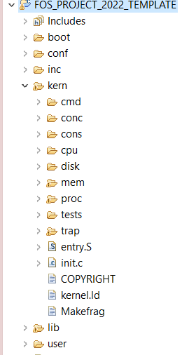





PROJECT BIG PICTURE
inc (.h)
lib (.c)
[MS1]
Dynamic Allocator
user
kern
[MS3]
Fault Handler, Heap,
Sharing & Semaphores
[MS3]
User Program
[MS2]
Helper F^{n}s & Kern Heap

Slide 4

Logistics
Startup Code & Changed Files:
Continue on the startup code from MS1 and MS2.
Before starting in MS3, SELECT ALL in “Changed files” folder, COPY & PASTE (REPLACE ALL) in FOS_CODES/FOS_PROJECT_2022_TEMPLATE/.
Delivery Method: GOOGLE FORMS
It’s FINAL delivery
MUST deliver the required tasks and ENSURE they’re worked correctly
Delivery Dates:
FRIDAY of Week #11 (16/12/2022 @11:59 PM)
Upload your code EARLY as NO EXCEPTION will be accepted.
Support:
The support for teams will be through their MENTORS ONLY (+LECTURER) during the published weekly office hours.

Slide 5
Logistics
ADVICE#1: WORK AS A TEAM
Milestone 3 Functions:
Load and run multiple user programs (already DONE) ➔ 0 function (ONLY explained)
Page Fault Handler ➔ 2 function
User Heap ➔ 4 functions
Shared Variables ➔ 4 functions
Semaphores ➔ 3 functions
Average # Functions / Member = 13 / 4 members
ADVICE#2: START immediately!
ADVICE#3: Get BENEFIT from MS1 & MS2 Functions
Some of the required functions depend on MS1 & MS2 functions. Make sure they’re correct → CALL THEM
ADVICE#4: MUST read the ppt CAREFULLY
Detailed steps
Helper ready made functions (appendices)
≈ 3 Functions on 3 Weeks

Slide 6
Agenda
Logistics
MS3 Quick Guide
MS3 Objective
MS3: 0- Load and run multiple user programs (ALREADY DONE & Explained ONLY)
MS3: 1- Page fault Handler
MS3: 2- User heap
MS3: 3- Shared Variables
MS3: 4- Semaphores
Testing Whole Project
FOS BONUS
How to submit?

Slide 7

Startup MS3 Code Quick Guide
Continue on the same template “FOS_PROJECT_2022_Template” from in MS1 and your code in MS2.
In the Release folder, you will find a folder named with “MS3 Changed Files”. Do the following:
Open this folder.
Select all what exist in “MS3 Changed Files” folder.
Copy them.
Go to “…your directory of fos_cygwin/FOS_CODES/FOS_PROJECT_2022_Template”.
Paste (replace all) in this destination what you copied in step 3.
In eclipse, right click “FOS_PROJECT_2022_Template”, select clean.
Run your code (No errors shall be obtained).
Start in implementing the required functions.
IMPORTANT NOTE
Before starting in the KHEAP functions, you MUST DO the following:
Go to 'inc/memlayout.h' and set USE_KHEAP by 1
Go to 'inc/dynamic_allocator.h' and set STATIC_MEMBLOCK_ALLOC by 0

Slide 8
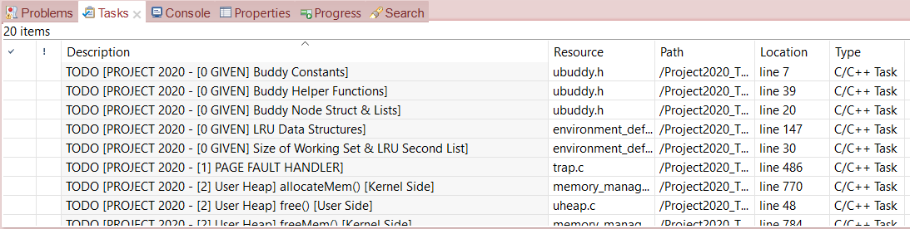
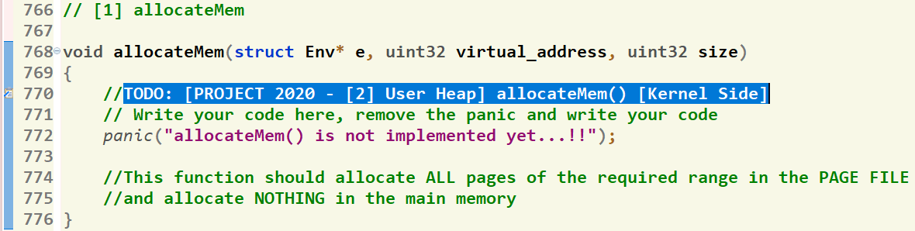
Where should I write the Code?
There’re shortcut links that direct you to the function definition
[1] Click on “Tasks” Tab
[2] Double Click on the required function
GIVEN
REQUIRED
[3] Function body, at which you should write the code
8

Slide 9

Helper Ready Made Functions
Set of ready-made functions are available to help you when writing your solution.
Detailed description can be found in this document.

Slide 10
Agenda
Logistics
MS3 Quick Guide
MS3 Objective
MS3: 0- Load and run multiple user programs (ALREADY DONE & Explained ONLY)
MS3: 1- Page fault Handler
MS3: 2- User heap
MS3: 3- Shared Variables
MS3: 4- Semaphores
Testing Whole Project
FOS BONUS
How to submit?

Slide 11
MS3 Objective
Create a PAGE DIRECTORY & WORKING SET for a process when loading it.
Handle PAGE FAULT using CLOCK page replacement algorithm.
Implement USER HEAP (using the dynamic allocator).
Implement SHARING to share variables between various processes.
Implement SEMAPHORES to enable OS to protect processes’ shared variables.

Slide 12
Agenda
Logistics
MS3 Quick Guide
MS3 Objective
MS3: 0- Load and run multiple user programs (ALREADY DONE & Explained ONLY)
MS3: 1- Page fault Handler
MS3: 2- User heap
MS3: 3- Shared Variables
MS3: 4- Semaphores
Testing Whole Project
FOS BONUS
How to submit?

Slide 13
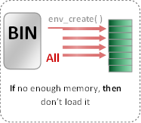
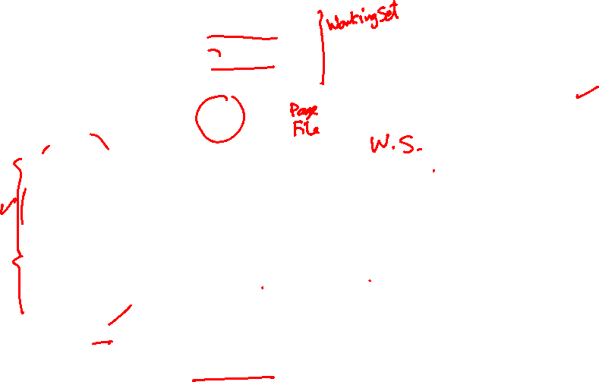
MS3: Loading Program [env_create]
Now: in Project
Prev: in Labs
env_create( )
BIN
Set of pages
Three kernel dynamic allocations:
create_page_table(): should create new page table and link it to the directory [already DONE].
create_user_page_WS(): should create new array for pages WS with the given size.
create_user_directory(): should create new user directory.
Required Tables
All Pages
BIN
Segment 1, page 1
Loaded in virtual address 201000
201000
WS_Last_index
Segment 1, page 2
Loaded in virtual address 202000
202000
Segment 1, page 3
203000
Loaded in virtual address 203000
Segment 2, page 1
801000
Loaded in virtual address 801000
Segment 2, page 2
USTAKTOP —PAGESIZE
NOT Loaded in main memory
Program Binary Segments and pages
Working Set after loading (pages_WS_size = 5)
First Stack Page

Slide 14

MS3: Loading Program [env_create]
create_user_page_WS(): It uses kmalloc() to allocate a new space for a working set with numOfElements elements
create_user_directory(): It uses kmalloc() to allocate a new directory
void * create_user_page_WS(struct Env * e, unsigned int numOfElements)
{
uint32 nBytes = sizeof(struct WorkingSetElement) * numOfElements;
struct WorkingSetElement* ptr_page_WS = kmalloc(nBytes);
if(ptr_page_WS == NULL)
panic("NOT ENOUGH KERNEL HEAP SPACE");
return ptr_page_WS;
}
void * create_user_directory()
{
uint32* ptr_user_page_directory = kmalloc(PAGE_SIZE);
if(ptr_user_page_directory == NULL)
panic("NOT ENOUGH KERNEL HEAP SPACE");
return ptr_user_page_directory;
}
Your Task: COPY & PASTE the code of BOTH functions in your project in kern/proc/user_environment.c

Slide 15
Agenda
Logistics
MS3 Quick Guide
MS3 Objective
MS3: 0- Load and run multiple user programs (ALREADY DONE & Explained ONLY)
MS3: 1- Page fault Handler
MS3: 2- User heap
MS3: 3- Shared Variables
MS3: 4- Semaphores
Testing Whole Project
FOS BONUS
How to submit?

Slide 16
MS3: Page Fault Handler
The main functions required by MS3 to handle “Page Fault” are:
# | Function | File
1 | page_fault_handler | Functions definitions TO DO in: kern/trap/fault_handler.c

Slide 17

MS3: Page Fault Handler: Introduction
Fault: is an exception thrown by the processor (MMU) to indicate that:
A page table is not exist in the main memory (i.e. new table). (see the following figure) OR
A page can’t be accessed due to either it’s not present in the main memory

Slide 18
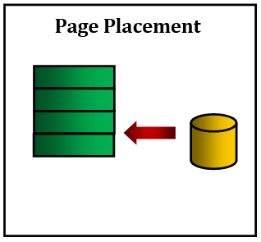
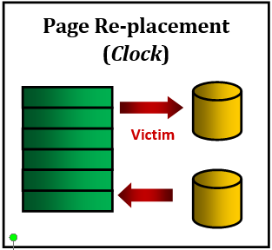
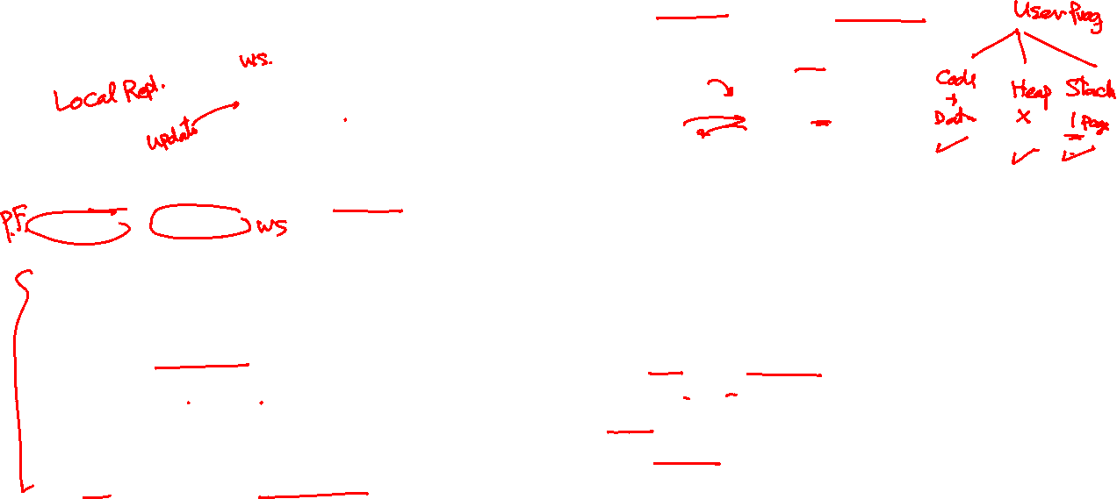
MS3: Page Fault Handler: Required Function
Function Declaration: void page_fault_handler(struct Env * curenv, uint32 fault_va)
Function Role:
If the size of the page working set < its max size, then do (refer to Appendix I and Appendix II)
Scenario 1: Placement
Allocate space for the faulted page
Read the faulted page from page file to memory
If the page does not exist on page file, then
If it is a stack or a heap page, then, it’s OK.
Else, a panic with an error message shall be output to show ILLEGAL MEMORY ACCESS for the given fault virtual address.
Reflect the changes in the page working set
Scenario 2: Replacement
Implement the clock algorithm to find victim virtual address from page working set to replace.
If the victim page is not modified, then:
Just remove it
Else
Update its page in page file
Then, remove it
Reflect the changes in the page working set
Apply Placement steps tp place the faulted page
NOTE: Check MS3 appendices to handle either the working set or the page file using some ready-made functions.

Slide 19

MS3: Page Fault Handler: Testing
Test each function in MS3 independently in a FRESH SEPARATE RUN
The time limit of each individual test: max of 15 sec / each
All below tests are used to validate the page_fault_handler function
# | Test Functionality | Test
1 | tst_placement.c (tpp): tests page faults on stack + page placement | FOS> run tpp 20
2 | tst_invalid_access.c (tia): tests handling illegal memory access for a page not belong to neither the stack nor the heap. (your panic of “ILLEGAL MEM ACCESS” should appear here. No success message in this test) | FOS> run tia 15
3 | tst_page_replacement_alloc.c (tpr1): tests allocation in memory and page file after page replacement. | FOS> run tpr1 11
4 | tst_page_replacement_stack.c (tpr2): tests page replacement of stack (creating, modifying and reading them) | FOS> run tpr2 6
5 | tst_page_replacement_mod_clock.c (tclock): tests page replacement by CLOCK algorithm | FOS> run tclock 11

Slide 20

Agenda
Logistics
MS3 Quick Guide
MS3 Objective
MS3: 0- Load and run multiple user programs (ALREADY DONE & Explained ONLY)
MS3: 1- Page fault Handler
MS3: 2- User heap
MS3: 3- Shared Variables
MS3: 4- Semaphores
Testing Whole Project
FOS BONUS
How to submit?

Slide 21

MS3: USER HEAP
The main functions required by MS3 to handle “User Heap” are:
# | Function | File
1 | initialize_dyn_block_system (User side) | All essential declarations in: inc/uheap.h Functions definitions TO DO in: lib/uheap.c
2 | malloc [Using First Fit] (User side)
3 | free (User side)
4 | free_user_mem(Kernel side) | Kern/mem/chunk_operations.c

Slide 22
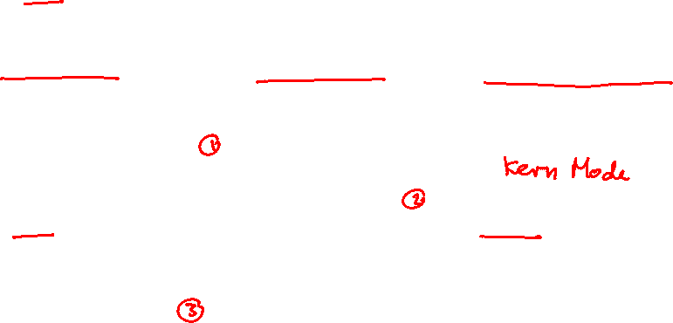
MS3: USER HEAP: Introduction
Before we start!
Program runs in user mode (less privileges)
It requires functions from the kernel
So, need to switch to kernel mode, call the function, then return to user mode
SYSTEM CALLS (S/W interrupts) do this job!

Slide 23

MS3: USER HEAP
Required Function 1- initialize_dyn_block_system
In MS1, we didn’t have dynamic allocation. So, we created MemBlockNodes statically with a constant size.
In MS2, we create this list for the kheap dynamically.
Now, we have a user heap which can be utilized to allocate array of MemBlockNodes in the memory dynamically.
MAX_MEM_BLOCK_CNT
MemBlockNodes
0 | 1 | 2 | …. |  | 100
…. | UH Pages
AvailableMemBlocksList

Slide 24
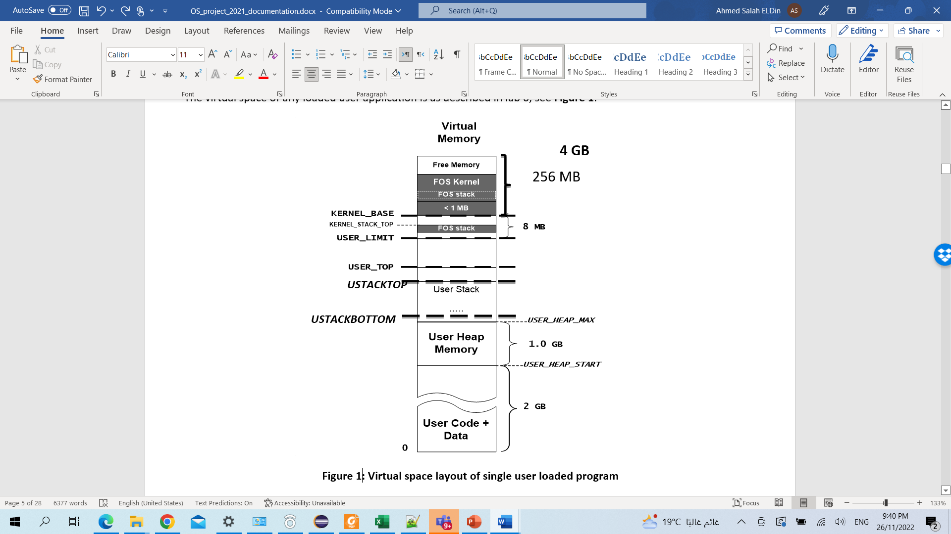
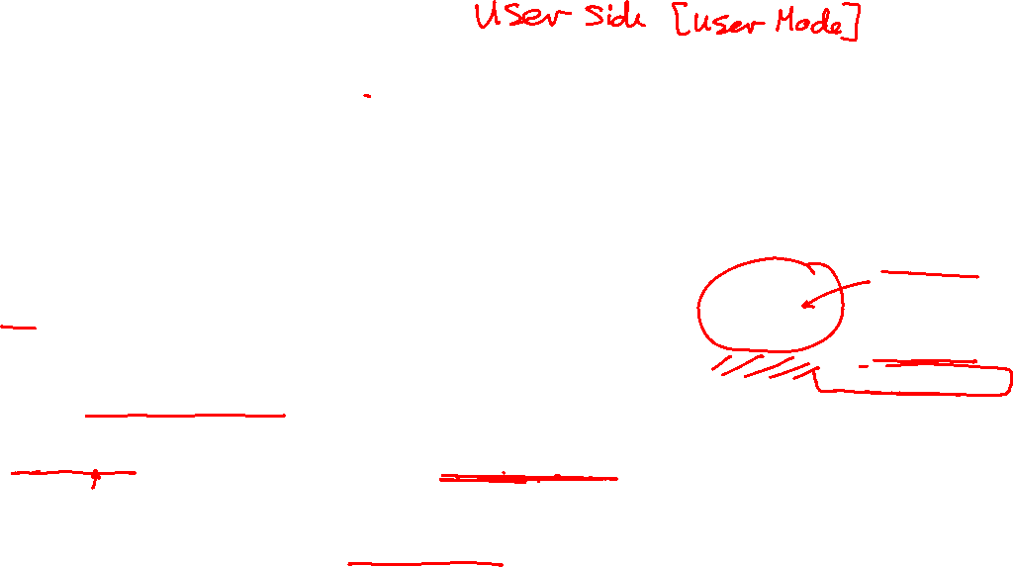
MS3: USER HEAP
Required Function 1- initialize_dyn_block_system
Function Declaration:
void initialize_dyn_block_system();
Function Role:
It initializes the dynamic blocking system by allocating MemBlockNodes array for USER HEAP dynamically as follows:
Initialize two lists (AllocMemBlocksList & FreeMemBlocksList) [Hint: use LIST_INIT()]
Dynamically allocate the array of MemBlockNodes at virtual address USER_DYN_BLKS_ARRAY
Remember to:
1. Set the global variable “MAX_MEM_BLOCK_CNT” with the number of pages in the USER heap.
2. Allocation should be aligned on PAGE boundary (4KB).
HINT: you can use allocate_chunk(...) by calling it via a SYSTEM CALL sys_allocate_chunk(...)
Initialize AvailableMemBlocksList by filling it with the MemBlockNodes
HINT: You can get BENEFIT from MS1 & MS2 Functions
Insert a new MemBlock with the ENTIRE heap size into the FreeMemBlocksList
USER_DYN_BLKS_ARRAY

Slide 25
MS3: USER HEAP
Required Function 2 & 3 - malloc() / free()
What?
Why?
Program need dynamic allocations for its normal work
De-allocations are necessary after finishing using allocated memory:
virtual address space fragmentation happens
Minimize virtual addresses fragmentation as possible

Slide 26

MS3: USER HEAP
Required Function 2 & 3 - malloc() / free()
Allocation
Example 1 (C++ and C):
C++: int * ptr_value = new int;
C: int * ptr_value = malloc(sizeof(int));
allocate 1 int (4 bytes) in virtual memory and return the allocated virtual address to “ptr_value”
Example 2 (C++ and C):
C++: float* arr = new float[200];
C: float* arr = malloc(sizeof(float) * 200);
allocate 200 floats (800 bytes) in memory and return the allocated address to “arr”

Slide 27

MS3: USER HEAP
Required Function 2 & 3 - malloc() / free()
De-allocation
Example 1 (C++ and C):
C++: delete ptr_value;
C: free(ptr_value);
deallocate (free) 1 int (4 bytes) from virtual memory at address “ptr_value”
Example 2 (C++ and C):
C++: delete[] arr;
C: free(arr);
de-allocate (free) 200 floats (800 bytes) from virtual memory at address “arr”

Slide 28
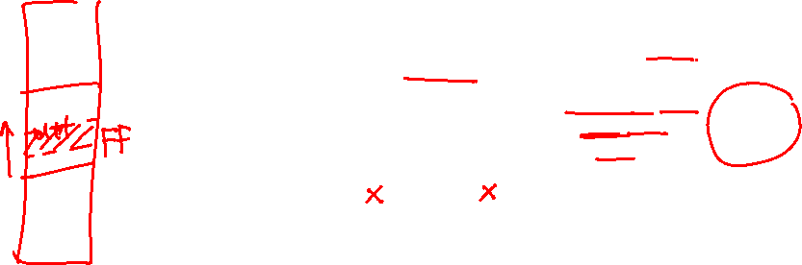
MS3: USER HEAP
Required Function 2 & 3 - malloc() / free()
User Dynamic malloc/free *
malloc( ) (First Fit)
free( )
Working Sets Pages + Empty Tables in Given Range
ALL Pages in Given Range
Nothing Created in Memory
Nothing Created in Page File

Slide 29
MS3: USER HEAP
Required Function 2- malloc()
Required Functions
[USER SIDE] Lib/uheap.c
void* malloc(uint32 size)
Implement FIRST FIT strategy to search the heap for suitable space to the required allocation size (space should be on 4 KB BOUNDARY)
If no suitable space found, return NULL
Else, return pointer containing the virtual address of allocated space

Slide 30
MS3: USER HEAP
Required Function 2- malloc()
Allocate pages on 4KB granularity
.
.
.
ptr3 = malloc (3 KB)
ptr3
3 KB
ptr2 = malloc (1 KB)
ptr2
1 KB
2 KB
4 KB
ptr1 = malloc (6 KB)
ptr1
USER_HEAP_START
.
.
.
MemBlockNodes
USER_DYN_BLKS_ARRAY

Slide 31
MS3: USER HEAP
Required Function 2- malloc()
.
.
.
USER_HEAP_MAX
2 MB
.
.
.
ptr4 = malloc (2 MB)
2 MB
ptr4
1 MB
3 MB
4 MB
FIRST FIT Strategy
ptr2 = malloc (3 MB)
ptr2
2 MB
ptr3 = malloc(1 MB)
ptr3
1 MB
3 MB
ptr1 = malloc (1 MB)
ptr1
1 MB
USER_HEAP_START
4 MB
MemBlockNodes
USER_DYN_BLKS_ARRAY
.
.
.

Slide 32
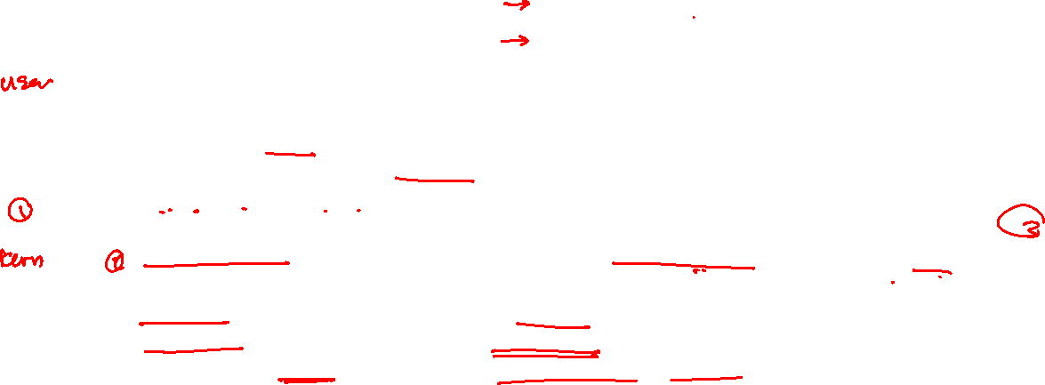
MS3: USER HEAP
Required Function 3 & 4 - free() / free_user_mem()
Required Functions
[USER SIDE] Lib/uheap.c [KERNEL SIDE] kern/mem/chunk_operations.c
void free(void* virtual_address)
Find the allocated size of the given virtual_address
Frees this allocation from the user Heap
Call “sys_free_user_mem” to free the allocation from the memory & page file
void free_user_mem(struct Env* e, uint32 virtual_address, uint32 size)
Free ALL pages of the given range from the Page File (Check MS3 appendix for PAGE FILE)
Free ONLY pages that are resident in the working set from the memory (Check MS3 appendix for WS)
Removes ONLY the empty page tables (i.e. no pages are mapped in it)

Slide 33

MS3: USER HEAP: Testing
Test each function in MS3 independently in a FRESH SEPARATE RUN.
The time limit of each individual test: max of 30 sec / each
# | Test Functionality | Test
1 | tst_malloc_0.c (tm0): tests the implementation initialize_dyn_block_system(). It validates all the lists of the dynamic allocator and their contents affected by initialize_dyn_block_system(). | FOS> run tm0 2000
2 | tst_malloc_1.c (tm1): tests the implementation malloc() & allocateMem(). It validates both the return addresses from the malloc() and the number of allocated frames by allocateMem(). | FOS> run tm1 2000
3 | tst_malloc_2.c (tm2): tests the implementation malloc() & allocateMem(). It checks the memory access (read & write) of the allocated spaces. | FOS> run tm2 2000
4 | tst_malloc_3.c (tm3): tests the implementation malloc() & allocateMem(). After accessing the memory, it checks the number of allocated frames and the WS entries. | FOS> run tm3 2000

Slide 34
MS3: USER HEAP: Testing [cont.]
Test each function in MS3 independently in a FRESH SEPARATE RUN.
The time limit of each individual test: max of 30 sec / each
# | Test Functionality | Test
5 | tst_free_1.c (tf1): tests the implementation free() & freeMem(). It validates the number of freed frames by freeMem(). | FOS> run tf1 2000
6 | tst_free_2.c (tf2): tests the implementation free() & freeMem(). It checks the memory access (read & write) of the removed spaces. | FOS> run tf2 2000
7 | heap_program.c (hp): tests the filling of empty locations in program’s working set after free. | FOS> run hp 12
8 | tst_first_fit_1.c (tff1): tests the first fit strategy by requesting allocations that always fit in one of the free segments. All requests should be granted. (Free & Free_user_mem MUST be working CORRECTLY). | FOS> run tff1 2000
9 | tst_first_fit_2.c (tff2): tests the first fit strategy by requesting allocations that can't fit in any of the free segments. All requests should NOT be granted (Free & Free_user_mem MUST be working CORRECTLY). | FOS> run tff2 2000

Slide 35

Agenda
Logistics
MS3 Quick Guide
MS3 Objective
MS3: 0- Load and run multiple user programs (ALREADY DONE & Explained ONLY)
MS3: 1- Page fault Handler
MS3: 2- User heap
MS3: 3- Shared Variables
MS3: 4- Semaphores
Testing Whole Project
FOS BONUS
How to submit?

Slide 36

MS3: Shared Variables
The main functions required by MS3 to handle “Shared Variables” are:
# | Function | File
1 | smalloc (User side) | Functions definitions TO DO in: lib/uheap.c
2 | sget (User side)
3 | createSharedObject(Kernel side) | Functions definitions TO DO in: kern/mem/shared_memory_manager.c
4 | getSharedObject(Kernel side)

Slide 37
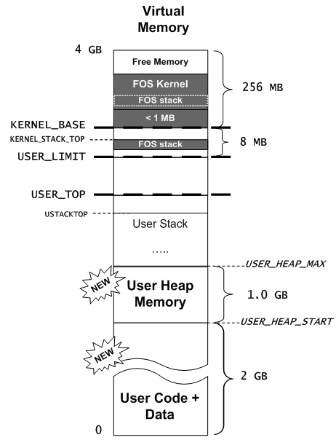

MS3: Shared Variables Introduction
Created and shared in the USER HEAP
FIRST FIT Strategy

Slide 38
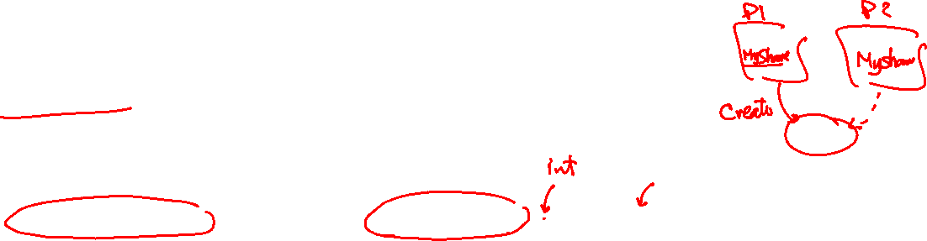
MS3: Shared Variables Required Function 1&2- smalloc/sget
Creation (Application 1):
int* ptr_sharedInt;
uint8 isWritable = 1;
ptr_sharedInt = smalloc(“mySharedInt”,4,isWritable);
allocate 4 bytes named “mySharedInt” in virtual memory and return the allocated virtual address to “ptr_sharedInt”
Specify its shared permission to be writable
*ptr_sharedInt = 70;
Set the value of the shared int to 70

Slide 39

MS3: Shared Variables Required Function 1&2- smalloc/sget
Access from other app. (Application 2):
int* ptr_sharedInt;
ptr_sharedInt = sget(App1ID, “mySharedInt”);
Search for the shared object, named “mySharedInt” and belong to App1ID
share it in app2, and return its virtual address in “ptr_sharedInt”
int sharedInt = *ptr_sharedInt;
Read its value (it should be 70)

Slide 40
MS3: Shared Variables Required Function 1 & 2- smalloc & sget
Create/Share pages on 4KB granularity
.
.
.
ptr3 = sget(ownerID, “z”)
ptr3
3 KB
ptr2 = smalloc(“y”, 1 KB, 0)
ptr2
1 KB
2 KB
4 KB
ptr1 = smalloc(“x”, 6 KB, 1)
ptr1
USER_HEAP_START
.
.
.
MemBlockNodes
USER_DYN_BLKS_ARRAY

Slide 41

MS3: Shared Variables Required Function 1 & 2- smalloc & sget
FIRST FIT Strategy
.
.
.
USER_HEAP_MAX
2 MB
.
.
.
z = sget(ownerID, “z”)
2 MB
z
1 MB
ptr3 = malloc (1 MB)
ptr3
1 MB
3 MB
4 MB
ptr2 = malloc (3 MB)
ptr2
2 MB
y = smalloc(“y”,1.5MB,0)
y
1.5 MB
3 MB
x = smalloc(“x”, 1 MB, 1)
x
1 MB
4 MB
USER_HEAP_START
.
.
.
MemBlockNodes
USER_DYN_BLKS_ARRAY

Slide 42
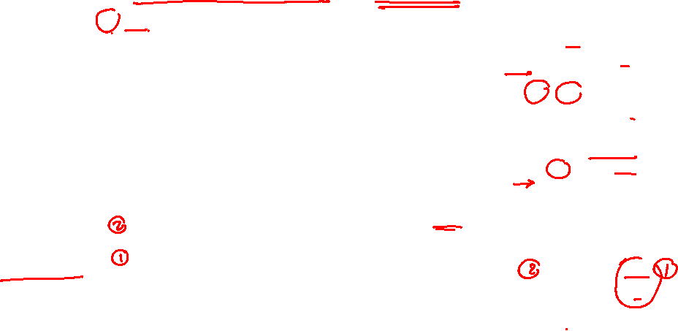
MS3: Shared Variables Required Function 1 & 2- smalloc & sget
smalloc(): Store allocated frames for later use
x = smalloc(“x”, 6 KB, 1)
Share Object 1
y = smalloc(“y”, 2 KB, 1)
Virtual.1
RAM
OwnerID=Env1ID,
Name = “x”, Size = 6 KB, …
.
.
.
…
Frames Storage
100
30
…
Share Object 2
OwnerID=Env1ID,
Name = “y”, Size = 2 KB, …
y
2 KB
…
4 KB
4 KB
F# 100
Frames Storage
99
…
2 KB
F# 99
2 KB
4 KB
…
USER_HEAP_START
x
30
99
100
.
.
.
...
R=1
…….
R=1
R=1
...
2 KB
F# 30
Frames_info
…

Slide 43

MS3: Shared Variables Required Function 1 & 2- smalloc & sget
sget(): Share the stored frame of the object.
Share Object 2
[Virt.3] y3 = sget(env1ID, “y”)
Share Object 1
[Virt.2] y2 = sget(env1ID, “y”)
[Virt.2] x2 = sget(env1ID, “x”)
OwnerID=Env1ID,
Name = “x”, Size = 6 KB, …
Virtual.1
Virtual.2
OwnerID=Env1ID,
Name = “y”, Size = 2 KB, …
Virtual.3
RAM
.
.
.
.
.
.
.
.
.
…
Frames Storage
Frames Storage
…
100
…
99
30
y
2 KB
4 KB
4 KB
F# 100
2 KB
4 KB
F# 99
2 KB
x2
2 KB
2 KB
y3
4 KB
4 KB
…
x
y2
2 KB
30
99
100
.
.
.
.
.
.
.
.
.
...
R=1
…….
R=1
R=1
...
R=2
R=3
R=2
R=2
2 KB
F# 30
Frames_info
…

Slide 44
MS3: Shared Variables
There are some GIVEN data structures and functions already implemented to help you in the required 4 functions

Slide 45
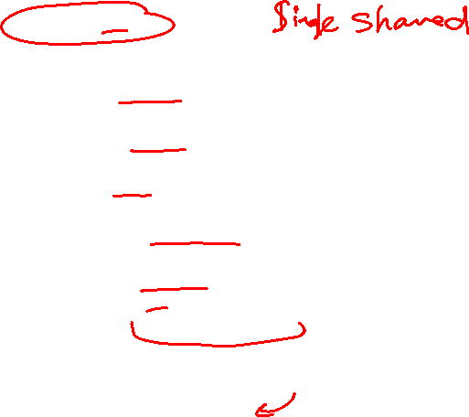
MS3: Shared Variables
Given Semaphores Data Structures
struct Share
{
//ID of the owner environment
int ownerID;
//share name
char name[64];
//share size
int size;
//references, number of envs looking at this shared mem object
uint32 references;
//sharing permissions (0: ReadOnly, 1:Writable)
uint8 isWritable;
//to store frames to be shared
uint32 *framesStorage;
}
//array of all shared objects
struct Share *shares ;
kern/mem/shared_memory_manager.h

Slide 46

MS3: Shared Variables Given Function 1: create_shares_array
void create_shares_array(int size) (DONE)
kern/mem/shared_memory_manager.c
It dynamically allocates the array of shared objects “shares”
It initializes it by 0's and set the empty flag = 1
ALREADY called for you ☺

Slide 47
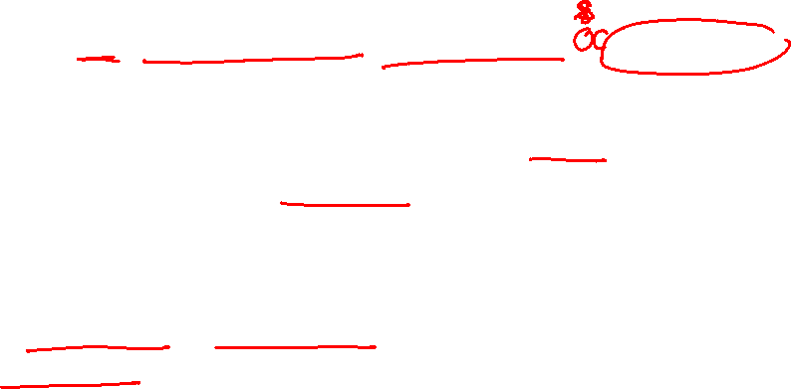
MS3: Shared Variables Given Function 2: allocate_share_object
int allocate_share_object(struct Share **allocatedObject) (DONE)
kern/mem/shared_memory_manager.c
It allocates a new (empty) shared object from the "shares" array
It dynamically creates the "framesStorage"
Return:
If succeed:
allocatedObject (pointer to struct Share) passed by reference
sharedObjectID (its index in the array) as a return parameter
E_NO_SHARE if the array of shares is full (i.e. reaches "MAX_SHARES")

Slide 48

MS3: Shared Variables Given Function 3: get_share_object_ID
It searches for shared object with the given “ownerID” & “name” in the “shares” array
If found, return its ID (i.e. its index in the “shares” array)
Else, return E_SHARED_MEM_NOT_EXISTS
int get_share_object_ID(int ownerID, char* name) (DONE)
kern/mem/shared_memory_manager.c

Slide 49

MS3: Shared Variables Given Function 4: free_share_object
int free_share_object(int sharedObjectID) (DONE)
kern/mem/shared_memory_manager.c
It deletes the object with given “sharedObjectID” from the "shares" array (i.e. set its empty flag to 1)
It deletes the "framesStorage" also
Return:
0 if succeed
E_SHARED_MEM_NOT_EXISTS if the shared object is not exists

Slide 50
MS3: Shared Variables Given Function 5: add_frame_to_storage
void add_frame_to_storage(uint32* frames_storage, struct FrameInfo* ptr_frame_info, uint32 index) (DONE)
kern/mem/shared_memory_manager.c
It adds the given “ptr_frame_info” to the “frames_storage” at the given “index”

Slide 51
MS3: Shared Variables Given Function 6: get_frame_from_storage
struct FrameInfo* get_frame_from_storage(uint32* frames_storage, uint32 index) (DONE)
kern/mem/shared_memory_manager.c
It gets a “frame info” from the “frames_storage” at the given “index”

Slide 52
MS3: Shared Variables
Required Function
[KERNEL SIDE] kern/shared_memory_manager.c
[USER SIDE] Lib/uheap.c
int createSharedObject(int32 ownerID, char* name, uint32 size, uint8 isWritable, void* virtual_address)
Allocate a new share object (use allocate_share_object())
Allocate ALL required space in the physical memory on a PAGE boundary
Map them on the given "virtual_address" on the current env. with WRITABLE permissions
Initialize the share object with the following:
Set the data members of the object with suitable values (ownerID, name, size, ...)
Set references to 1 (as there's 1 user environment that use the object now - OWNER)
Store the object's isWritable flag for later use by getSharedObject()
Add all allocated frames to "frames_storage" of this shared object to keep track of them for later use (use: add_frame_to_storage())
If succeed: return the ID of the shared object (i.e. its index in the "shares" array)
Else, return suitable error
void* smalloc(char* name, uint32 size, uint8 isWritable)
Implement FIRST FIT strategy to search the heap for suitable space to the required allocation size (on 4 KB BOUNDARY)
if no suitable space found, return NULL
Call sys_createSharedObject(...) to invoke the Kernel for allocation of shared variable
If the Kernel successfully creates the shared variable, return its virtual address
Else, return NULL

Slide 53
MS3: Shared Variables
Required Function
[KERNEL SIDE] kern/shared_memory_manager.c
[USER SIDE] Lib/uheap.c
int getSharedObject(int32 ownerID, char* name, void* virtual_address)
Get the shared object from the "shares" array (use get_share_object_ID())
Get its physical frames from the “frames_storage” (use: get_frame_from_storage())
Share these frames with the current env. starting from the given "virtual_address"
use the flag isWritable to make the sharing either read-only or writable
If succeed: Update references & return the ID of the shared object (i.e. its index in the "shares" array)
Else, return suitable error
void* sget(int32 ownerID, char* name)
Get the size of the shared variable (use sys_getSizeOfSharedObject())
If not exists, return NULL
Implement FIRST FIT strategy to search the heap for suitable space (on 4 KB BOUNDARY)
if no suitable space found, return NULL
Call sys_getSharedObject(...) to invoke the Kernel for sharing this variable
If the Kernel successfully share the variable, return its virtual address
Else, return NULL

Slide 54
MS3: Shared Variables Testing
Test each function in MS3 independently in a FRESH SEPARATE RUN
The time limit of each individual test: max of 30 sec / each
# | Function | Test
1 | smalloc & createSharedObject tst_sharing_1.c (tshr1): It tests the creation of shared objects. It validates the returned addresses and the number of allocated frames. It also checks the memory access (read & write) of the created shared objects. | Test 1: FOS> run tshr1 2000
2 | smalloc & createSharedObject tst_sharing_3.c (tshr3): It tests handling the special cases of shared objects creation. Namely, creating objects with same name, creating large object that exceeds heap area and creating large number of objects that exceed the max allowed objects. | Test 1: FOS> run tshr3 2000
3 | Sget & getSharedObject tst_sharing_2master.c (tshr2): It tests the request for sharing object. It validates the returned addresses and the number of allocated frames. It also checks the memory access (read & write) of the retrieved shared objects with different read/write permissions. | Test 1: FOS> run tshr2 2000
4 | tst_first_fit_3.c (tff3): tests the first fit strategy by requesting normal and shared allocations that always fit in one of the free segments. All requests should be granted. | Test 1: FOS> run tff3 2000

Slide 55

MS3: Shared Variables BONUS 1: Free Shared Object
Function Declaration:
Function Role:
Get the shared object from the shares array
Unmap it from the current environment
If page table(s) become empty, remove it
Update references
If this is the last share, delete the share object (use free_share_object())
Flush the cache
# | Function | File
1 | void sfree(void* virtual_address) (User side) | Functions definitions TO DO in: lib/uheap.c
2 | int freeSharedObject(int32 sharedObjectID, void *startVA) (Kernel side) | Functions definitions TO DO in: Kern/mem/shared_memory_manager.c
TESTING
Test | Test Functionality
FOS> run tshr4 2000 | tst_sharing_4.c: Tests the free of shared object after creating it.
FOS> run tshr5 2000 | tst_sharing_5_master.c: Tests the free of shared object after creating & getting it.

Slide 56
Agenda
Logistics
MS3 Quick Guide
MS3 Objective
MS3: 0- Load and run multiple user programs (ALREADY DONE & Explained ONLY)
MS3: 1- Page fault Handler
MS3: 2- User heap
MS3: 3- Shared Variables
MS3: 4- Semaphores
Testing Whole Project
FOS BONUS
How to submit?

Slide 57
MS3: Semaphores
The main functions required by MS3 to handle “Semaphores” are:
# | Function | File
1 | createSemaphore() | All essential declarations in: kern/conc/semaphore_manager.h Functions definitions TO DO in: kern/conc/semaphore_manager.c
2 | waitSemaphore()
3 | signalSemaphore()

Slide 58
MS3: Semaphores Introduction
OS-supported solution that can be used for:
Critical Section

Slide 59
MS3: Semaphores Introduction (Cont.)
Semaphore Usage:
Dependency

Slide 60
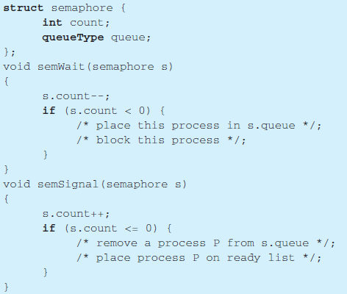
MS3: Semaphores Introduction (Cont.)

Slide 61
MS3: Semaphores Introduction (Cont.)
There are some GIVEN data structures and functions already implemented to help you in the required 3 functions
Given:
Data Structure
Queue Functions
Other Helper Functions
Your Task:
Write the code of wait & signal function

Slide 62
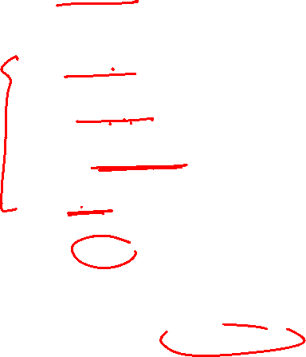
MS3: Semaphores Given Semaphores Data Structures
struct Semaphore
{
//owner environment ID
int ownerID;
//semaphore name
char name[64];
//queue of all blocked envs on this Semaphore
struct Env_Queue env_queue;
//semaphore value
int value;
//indicate whether this object is empty or used
uint8 empty;
};
// Array of available Semaphores
struct Semaphore *semaphores ;

Slide 63

MS3: Semaphores Given Function 1: create_semaphores_array
void create_semaphores_array(int size) (DONE)
kern/conc/semaphore_manager.c
It dynamically allocates the array of semaphore objects “semaphores”
It initializes it by 0's and set the empty flag = 1
ALREADY called for you ☺

Slide 64
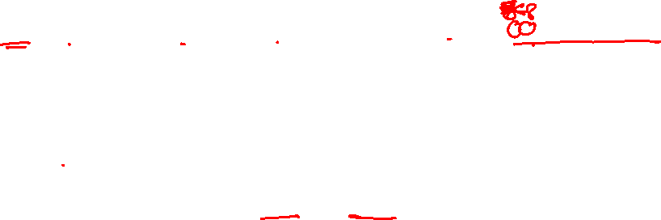
MS3: Semaphores Given Function 2: allocate_semaphore_object
int allocate_semaphore_object(struct Semaphore **allocatedObject) (DONE)
kern/conc/semaphore_manager.c
Allocates a new (empty) semaphore object from the “semaphores" array
Return:
If succeed:
allocatedObject (pointer to struct Semaphore) passed by reference
semaphoreObjectID (its index in the array) as a return value
E_NO_SEMAPHORE if the “semaphores” array is full

Slide 65
MS3: Semaphores Given Function 3: get_semaphore_object_ID
int get_semaphore_object_ID(int ownerID, char* name) (DONE)
kern/conc/semaphore_manager.c
Search for semaphore object with the given “ownerID” & “name” in the “semaphores” array
If found, return its ID (i.e. its index in the “semaphores” array)
Else, return E_SEMAPHORE_NOT_EXISTS

Slide 66
MS3: Semaphores Given Queue Functions
void enqueue(struct Env_Queue* queue, struct Env* env)(DONE)
struct Env* dequeue(struct Env_Queue* queue) (DONE)
kern/CPU/sched.c

Slide 67
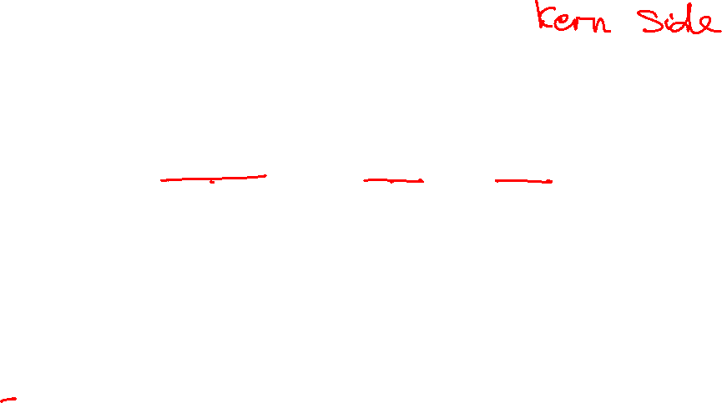
MS3: Semaphores Required Function 1: createSemaphore()
Function Declaration:
int createSemaphore(int ownerEnvID, char* name, int value)
Function Role:
If exists, return E_SEMAPHORE_EXISTS
Else, allocate a new semaphore object
If allocation succeed,
initialize its members (ownerID, name, value)
Return its ID (index in the array)
Else, return E_NO_SEMAPHORE

Slide 68
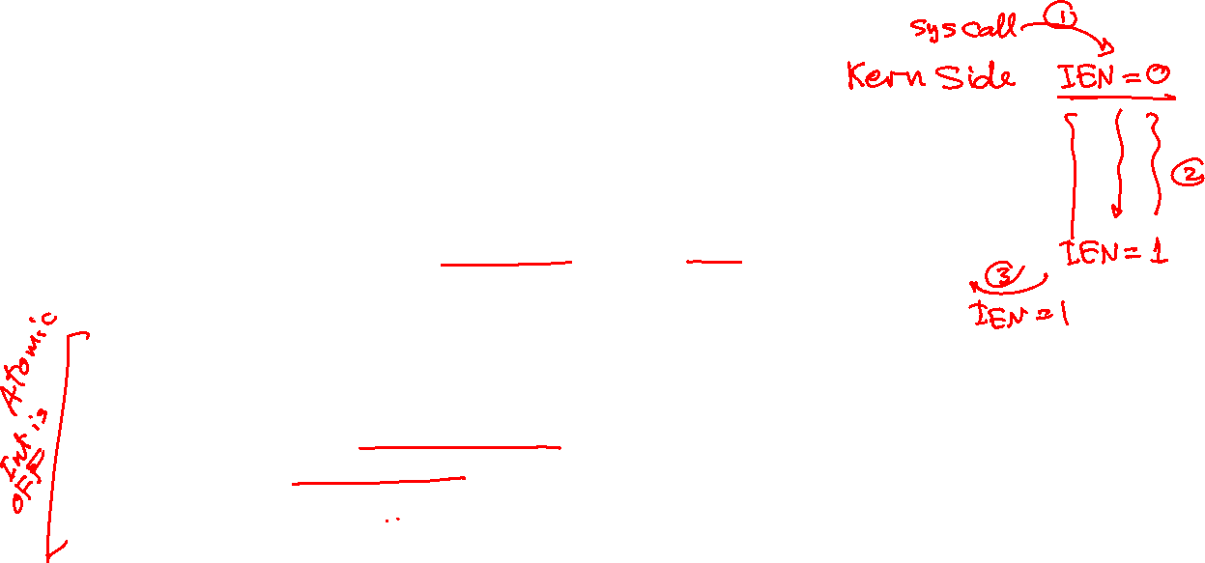
MS3: Semaphores Required Function 2: waitSemaphore()
Function Declaration:
void waitSemaphore(int ownerEnvID, char* name)
Function Role:
Get the Semaphore
Decrement its value
If negative, block the calling environment, by
adding it to semaphore queue [refer to helper functions in doc]
changing its status to ENV_BLOCKED
Call "fos_scheduler()" to continue running the remaining envs
Refer to MS3 APPENDIX for Scheduler Helper Functions

Slide 69

MS3: Semaphores Required Function 3: signalSemaphore()
Function Declaration:
void signalSemaphore(int ownerEnvID, char* name)
Function Role:
Get the Semaphore
Increment its value
If less than or equal 0, release a blocked environment, by
removing it from semaphore queue [refer to helper functions in doc]
adding it to ready queue [refer to helper functions in doc]
changing its status to ENV_READY
Refer to MS3 APPENDIX for Scheduler Helper Functions

Slide 70
MS3: Semaphores Testing
Test each function in MS3 independently in a FRESH SEPARATE RUN
The time limit of each individual test: max of 30 sec / each
All below tests are used to validate the 3 functions TOGETHER
# | Test Functionality | Test
1 | tst_semaphore_1master.c (tsem1): tests the implementation of wait & signal by using the Semaphores for handling the critical section and the dependency. | Test 1: FOS> run tsem1 100
2 | tst_semaphore_2master.c (tsem2): tests the implementation of wait & signal by using the Semaphores for allowing certain number of processes to enter the critical section at the same time. | Test 1: FOS> run tsem2 100 o Enter total number of customers: 100 o Enter shop capacity: 30

Slide 71
Agenda
Logistics
MS3 Quick Guide
MS3 Objective
MS3: 0- Load and run multiple user programs (ALREADY DONE & Explained ONLY)
MS3: 1- Page fault Handler
MS3: 2- User heap
MS3: 3- Shared Variables
MS3: 4- Semaphores
Testing Whole Project
FOS BONUS
How to submit?

Slide 72

MS3 Individual Tests: Dependency Graph
Dynamic Allocator
Kernel Heap
PLACEMENT (tpp)
Invalid Access
(outside stack)
Malloc0
(initialize)
Page Repl.2 (STACK)
Page Repl.1 (ALLOC)
Malloc1
(addr & alloc)
Page Repl. (clock)
Share1 (create)
Sem1
(wait&signal)
Malloc2
(mem access)
Malloc3
(WS & pages)
Share2 (Get)
Share3 (create: special cases)
Sem2
(wait&signal)
Free1
(freed space&WS)
HeapProg
(fill WS after free)
First Fit 1
(can fit)
Free2
(mem access)
First Fit 2
(can NOT fit)
First Fit 3
(normal & shared)

Slide 73
Project ENTIRE Tests: Scenarios
Test each scenario independently in a FRESH SEPARATE RUN
The time limit of each one: max of 1 min / each

Slide 74

Testing Whole Project – Scenario 1 Running single program to Test ALL MODULES TOGETHER
REQUIRED MODULES: 1. KERNEL Heap 2. USER Heap (malloc & free) 3. Page Fault Handler (placement + replacement) Scenario Sequence (DO the following to TEST this scenario): FOS> run tqsfh 7 //run tst_quicksort_freeHeap
Number of Elements = 1,000 Initialization method : Ascending Do you want to repeat (y/n): y
Number of Elements = 5,000 Initialization method : Descending Do you want to repeat (y/n): y
Number of Elements = 300,000 Initialization method : Semi random Do you want to repeat (y/n): n “At each step, the program should sort the array successfully”

Slide 75
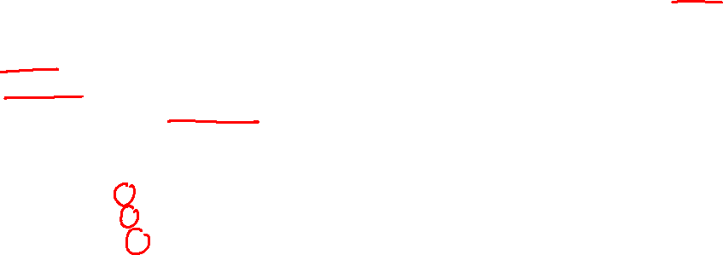
Testing Whole Project – Scenario 2 Running multiple programs with PAGES suffocation (1)
REQUIRED MODULES: 1. KERNEL Heap 2. USER Heap (malloc ONLY) 3. Page Fault Handler (replacement)
Scenario Sequence (DO the following to TEST this scenario): 1. FOS> load fib 7 //load Fibonacci program 2. FOS> load tqs 7 //load Quick sort program [with leakage] 3. FOS> load ms2 7 //load Merge sort program [with leakage] 4. FOS> runall //run all of them together
Test them according to the following steps: [Fibonacci] Fibonacci index = 30 “Result should = 1346269”

Slide 76
Testing Whole Project – Scenario 2 Running multiple programs with PAGES suffocation (2)
[QuickSort]
Number of Elements = 1,000 Initialization method : Ascending Do you want to repeat (y/n): y
Number of Elements = 1,000 Initialization method : Semi random Do you want to repeat (y/n): n “At each step, the program should sort the array successfully”
[MergeSort]
Number of Elements = 32 Initialization method : Ascending Do you want to repeat (y/n): y
Number of Elements = 32 Initialization method : Semi random Do you want to repeat (y/n): n “At each step, the program should sort the array successfully”

Slide 77

Testing Whole Project – Scenario 3 Effect of Memory Leakage!!
REQUIRED MODULES: 1. KERNEL Heap 2. USER Heap (Efficiency of First Fit) 3. Page Fault Handler (placement + replacement)
Scenario Sequence (DO the following to TEST this scenario): FOS> run ms1 20 //run Merge sort with NO memory leakage
Number of Elements = 5,000 Initialization method : Ascending Do you want to repeat (y/n): n “the program should sort the array successfully”
FOS> run ms2 20 //run Merge sort that CAUSE memory leakage
Number of Elements = 5,000 Initialization method : Semi random Do you want to repeat (y/n): n “the program should sort the array successfully”
WHAT Happens?! WHY?

Slide 78

Testing Whole Project – Scenario 4 Concurrent Programs & Shared Variables
REQUIRED MODULES: 1. KERNEL Heap 2. USER Heap (malloc & free) 3. Shared Variables 4. Page Fault Handler (placement only)
Scenario Role: This program creates a shared integer array, initializes it, and then invokes three different programs that operate on this array, as follows: 1. Program1: apply quick sort algorithm to sort the array and return the result in another array 2. Program2: apply merge sort algorithm to sort the array and return the result in another array 3. Program3: calculate some statistics on the array (min, max, mean, …etc) and return them
Scenario Sequence (DO the following to TEST this scenario): Number of Elements = 1,000 Initialization method : Semi random Do you want to repeat (y/n): n “the program should apply the three operations successfully”

Slide 79
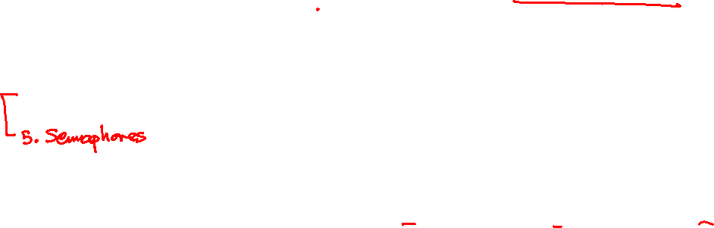
Testing Whole Project – Scenario 5 Concurrent Programs & Semaphores
REQUIRED MODULES: 1. KERNEL Heap 2. USER Heap (malloc & free) 3. Shared Variables 4. Page Fault Handler (replacement)
Scenario Role: This test simulate the “Air Plane Reservation” problem of LAB9 (refer to the lab for more details about the problem description). It assumes the following numbers: 1. numOfCustomers = 15 (flight1Customers = 3, flight2Customers = 8, flight3Customers = 4) 2. flight1NumOfTickets = 8 3. flight2NumOfTickets = 15
Scenario Sequence (DO the following to TEST this scenario): FOS> run tair 10 “the program should correctly finishes the required reservations

Slide 80
Agenda
Logistics
MS3 Quick Guide
MS3 Objective
MS3: 0- Load and run multiple user programs (ALREADY DONE & Explained ONLY)
MS3: 1- Page fault Handler
MS3: 2- User heap
MS3: 3- Shared Variables
MS3: 4- Semaphores
Testing Whole Project
FOS BONUS
How to submit?

Slide 81

MS3: USER HEAP BONUS 2: Free the entire environment (exit)
Function Declaration:
# | Function | File
1 | void env_free(struct Env *e) | Functions definitions TO DO in: kern/proc/user_environment.c
Free the entire environment (exit)
All pages in the page working set
The working set itself
The MemBlockNodes array of the USER HEAP dynamic allocator [if exists]
Shared variables [if any]
Semaphores [if any]
All page tables in the entire USER virtual memory
Directory table
All pages from page file, this code is already written for you ☺

Slide 82

WHOLE FOS BONUS 3
If you discover any issue in the FOS:
Performance issue
Security/Protection issue
Any other technical issue to act as a real OS.
Try to get a solution for it, i.e., no implementation is required, only the solution explanation.
Fill-up this WORD document with TWO main sections:
The issue explained in a detailed and clear way.
The solution explained in a detailed and clear way.

Slide 83
Agenda
Logistics
MS3 Quick Guide
MS3 Objective
MS3: 0- Load and run multiple user programs (ALREADY DONE & Explained ONLY)
MS3: 1- Page fault Handler
MS3: 2- User heap
MS3: 3- Shared Variables
MS3: 4- Semaphores
Testing Whole Project
FOS BONUS
How to submit?

Slide 84
Submission Rules
Read the following instructions as the code correction is done AUTOMATICALLY. Any violation in these rules will lead to 0 and nothing in this case couldn’t happened.
First ensure the following that (READ CAREFULLY):
You tested each function in a FRESH RUN and a congratulations message have been appeared.
You submitted BEFORE the deadline by several hours to AVOID any internet problems.
DEADLINE: FRIDAY of Week #11 (16/12/2022 @11:59 PM)
ONLY ONE person from the team shall submit the code.
The TEAM # MUST BE CORRECT.
NO DELAYED submissions WILL BE ACCEPTED.
NO CODE with errors WILL BE CORRECTED. So, CLEAN & RUN your project several times before your submission.
DON’T take the FORM LINK FROM ANYONE. OPEN the form from its LINK HERE ONLY. Otherwise, your submission is AUTOMATICALLY CANCELLED by GOOGLE.
You MUST RECEIVE A MAIL FROM GOOGLE with your submission after clicking submit. If nothing received, re-submit again to consider your submission.

Slide 85
Submission Steps
STEPS to SUBMIT:
Step 1: Clean & run your code the last time to ensure that there are any errors.
Step 2: Create a new folder and name it by your team number ONLY. Example 1 or 95. [ANY extra characters will lead to ZERO].
Step 3: COPY the following files:
dynamic_allocator.c, uheap.c ➔ Exist in lib folder
paging_helpers.c, chunk_operations.c, kheap.c & shared_memory_manager.c ➔ Exist in kern/mem folder
fault_handler.c ➔ Exist in kern/trap folder
semaphore_manager.c ➔ Exist in kern/conc folder
Step 4: PASTE the above 8 files in the folder created in step #2.
Step 5: Zip the created new folder. Its name shall be like [number of your team.zip]. [ANY extra characters will lead to ZERO].
Step 6: Open the form from HERE.
Step 7: Fill your team’s info .. Any wrong information will cancel your submission, revise them well.
Step 8: Upload the zipped folder in step 5 to the form in its field.
Step 9: MUST RECEIVE A MAIL from GOOGLE with your submission, otherwise re-submit again.
NOTE: Check an example for an uploaded file here

Slide 86
Thank you for your care…
Enjoy making your own FOS ☺

